Slide 1

CSA0501 - DATABASE MANAGEMENT SYSTEMS
Iot Based Smark Parking Management System Using
Er Modeling And Relational Database Design
PRESENTED BY:
P. Jessica Hephzbah(192511425)
K. Tejaswi(192525407)
S. Swetha(192565101)
GUIDED BY:
Dr. Jaya Mabel Rani

Slide 2


INTRODUCTION
This project is called the IoT-Based Smart Parking Management System
It helps drivers find empty parking slots using sensors and a database
Finding an empty slot by hand is slow and causes traffic jams
Our system uses IR sensors and an ESP32 chip to check if a slot is empty or full
This data is sent to a database in real time
A web app shows users which slots are free
This presentation covers: system design, database design, hardware setup, and results

Slide 3
PROBLEM STATEMENTS AND OBJECTIVES
Problem Statement
Drivers waste time searching for empty parking slots
This searching adds to traffic jams near parking areas
Parking staff track slots by hand, which leads to mistakes
There is no way to check slot status from outside the parking area
Objectives
Build a system that checks parking slots using IoT sensors
Design an ER model and database to store parking data
Send slot status to the database in real time
Show free slots to users through a web app
Reduce the time and effort needed to find parking

Slide 4
Objectives
To develop an IoT-based smart parking management system.
To design an ER model and relational database for parking data.
To monitor parking slots in real time using IoT sensors.
To display parking availability through a web application.
To improve parking efficiency and reduce manual effort.

Slide 5
EXISTING SYSTEM AND PROPOSED
SYSTEMS
Existing System
Parking staff check slots by walking around or using cameras
No way to know slot status without checking in person
Leads to delays, human error, and traffic near the gate
Proposed System
IR sensors detect if a slot is empty or full, automatically
ESP32 sends this data to a database over Wi-Fi
Web app shows live slot status to any user
Removes the need for manual checking

Slide 6
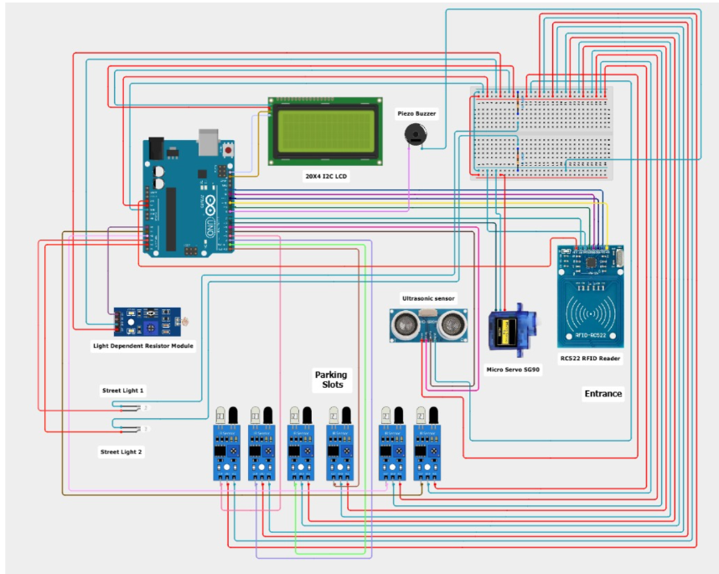
Circuit Diagram
Shows how the ESP32, IR sensors, servo motor, LCD, LEDs, and buzzer are connected
ESP32 is the main controller — all parts connect to it
IR sensors send slot status to the ESP32
ESP32 controls the LCD, LEDs, buzzer, and gate motor based on that status

Slide 7
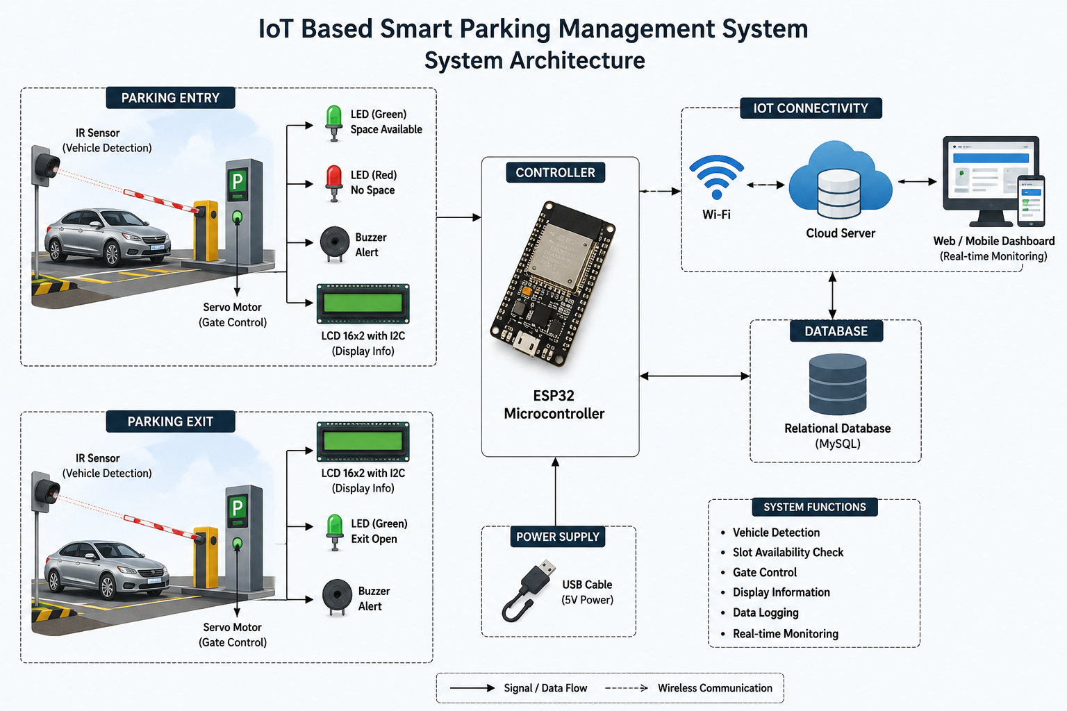
SYSTEM ARCHITECTURE
IR sensors check each parking slot
ESP32 collects this data and sends it over Wi-Fi
Data is stored in the database
Web app reads the database and shows free slots to the user
User sees live parking status on their phone or screen

Slide 8
COMPONETS USED
Component | Quantity | Purpose
ESP32 Microcontroller | 1 | Controls the system and sends sensor data via Wi-Fi
IR Sensors | 4 | Detect whether each parking slot is occupied or vacant
Servo Motor | 1 | Automates the parking gate opening and closing
LCD 16×2 with I2C | 1 | Displays the number of available parking slots
LEDs (Red/Green) | 4 | Indicate the status of each parking slot
Buzzer | 1 | Alerts when a vehicle enters the parking area
Breadboard | 1 | Provides a platform for circuit connections
Jumper Wires | Multiple | Connect electronic components
USB Cable | 1 | Powers and programs the ESP32

Slide 9
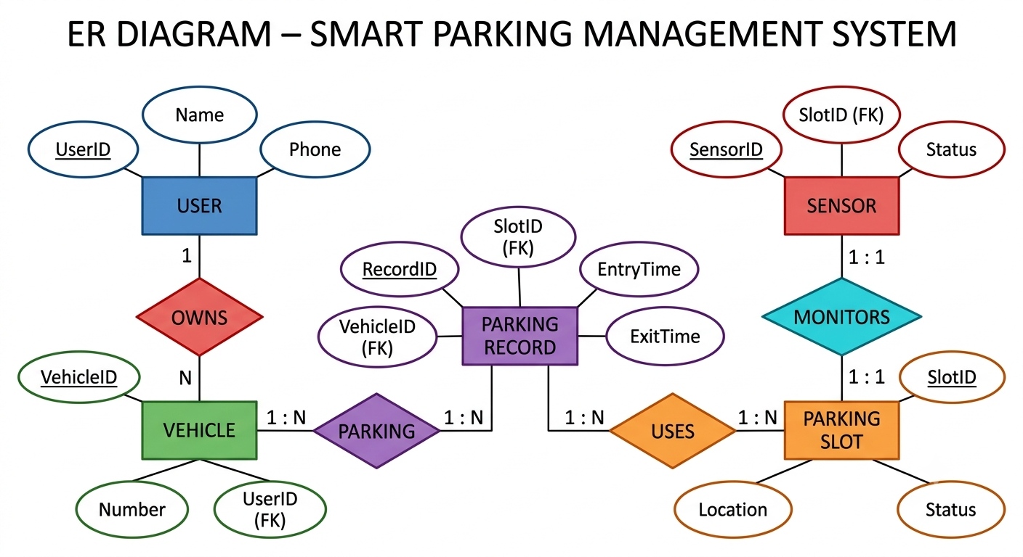
ER Diagram
Shows how User, Vehicle, ParkingSlot, ParkingRecord, and Sensor connect
One user can own many vehicles
Each parking event is tracked through a Parking Record
Each slot has a sensor that updates its status
This is the base for the tables shown in the next slide

Slide 10
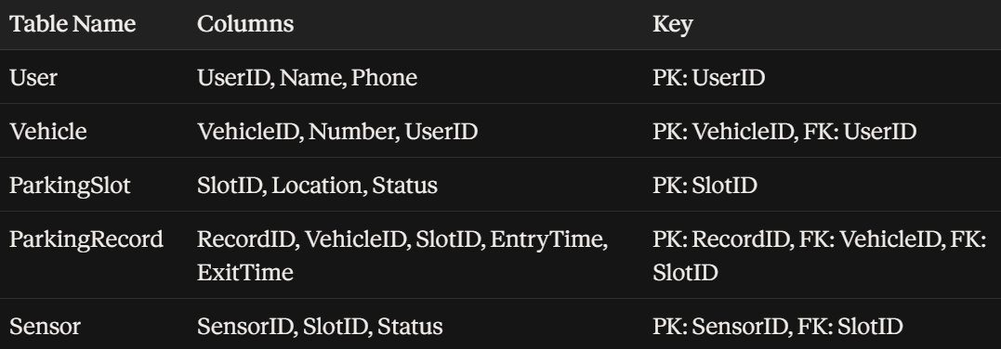
Relational Schema

Slide 11
Normalization
What is normalization?
A process that organizes data to avoid repeating the same information
Splits one large table into smaller, related tables
Keeps data consistent and saves storage space
How we used it in our project
Without normalization, owner name and slot details would repeat in every parking record
We split this into separate tables: User, Vehicle, ParkingSlot, and ParkingRecord
Each piece of data is stored only once
Tables are linked using foreign keys instead of repeating data

Slide 12
Module 1 – Hardware & IoT Data Acquisition
IR sensors detect whether each parking slot is occupied or vacant.
ESP32 microcontroller collects and processes sensor data.
Sensor data is transmitted to the database via Wi-Fi.
LCD 16×2 displays the number of available parking slots.
LEDs indicate the status of each parking slot (Green – Vacant, Red – Occupied).
Servo motor automatically opens and closes the parking gate.
Buzzer provides an alert when a vehicle enters the parking area.
Enables real-time monitoring of parking slot availability.

Slide 13
Module 2 – Database Management
Receives real-time slot status sent by the ESP32 over Wi-Fi
Stores data in 5 tables: User, Vehicle, ParkingSlot, ParkingRecord, Sensor
Updates ParkingSlot status automatically whenever a sensor value changes
Creates a new ParkingRecord each time a vehicle enters, with entry time
Updates the ParkingRecord with exit time when the vehicle leaves
Uses foreign keys to keep Vehicle, User, and Slot data linked correctly
Provides the data that the web application reads and displays to users

Slide 14
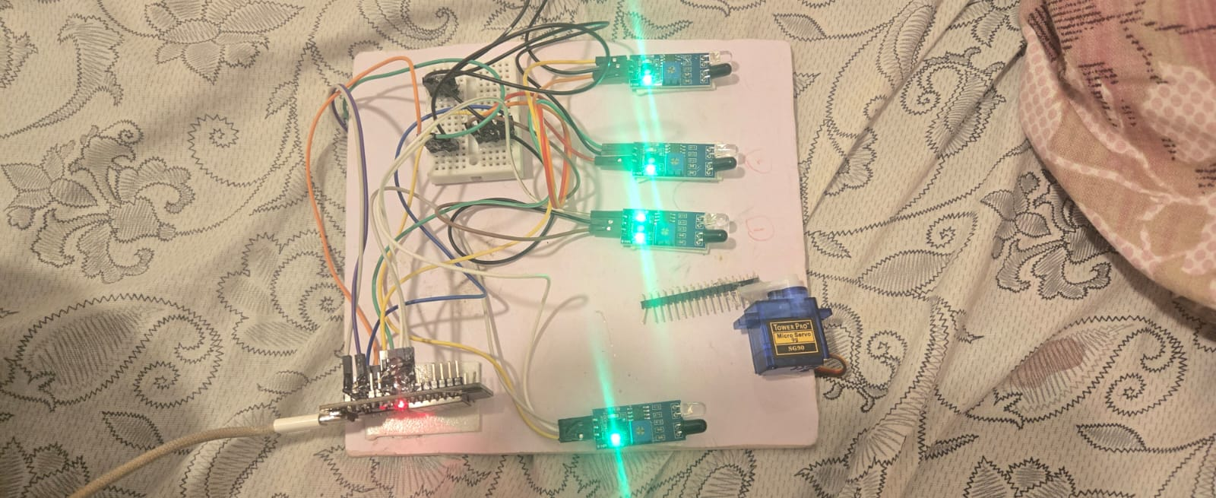
Module 3 – Web Application
Connects to the database to fetch the latest parking slot status
Displays free and occupied slots to the user in real time
Refreshes automatically, so users always see current availability
Simple interface — no manual searching needed
Helps users pick a slot before arriving at the parking area
Reduces traffic and time wasted looking for parking

Slide 15
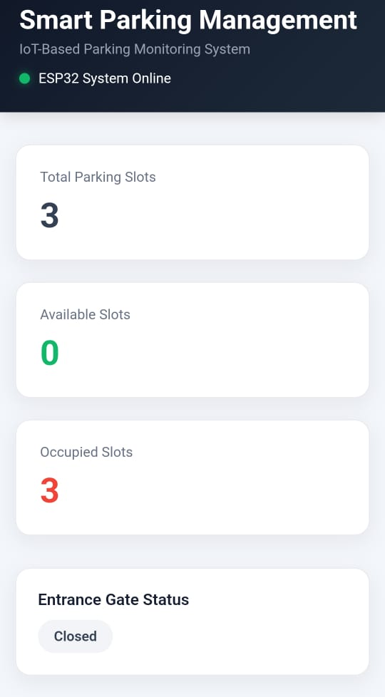
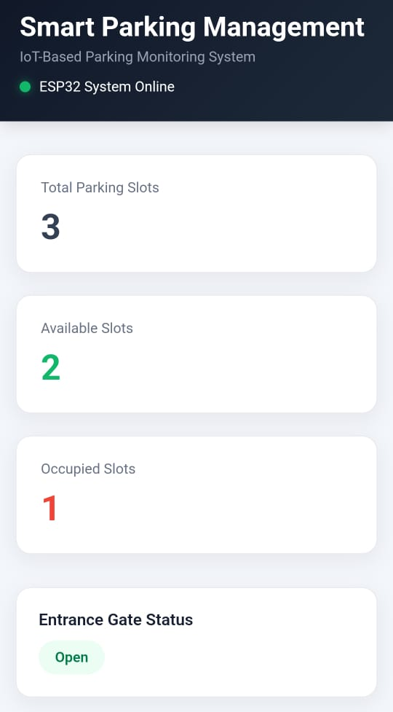
OUTPUT
Screenshot of the web app showing free and occupied slots
Photo of the LCD display showing number of free slots
Photo of the hardware setup (ESP32 + sensors + LEDs)
Photo/video frame of the gate opening for a vehicle
Screenshot of the database table showing stored records

Slide 16
RESULTS COMPARSION
Criteria | Manual/Existing System | Our Proposed System
Slot detection | Manual checking by staff | Automatic via IR sensors
Time to find a slot | Several minutes | Instant (checked on app)
Accuracy | Prone to human error | Sensor-based, more accurate
Real-time updates | Not available | Yes, live status
Record keeping | Manual/paper-based | Stored in database automatically
Traffic near entrance | Higher (searching cars) | Reduced (users know slot in advance)

Slide 17
IEEE STANDARDS
IEEE Standard | Description | Application in the Project
IEEE 802.11 (Wi-Fi) | Wireless Local Area Network (WLAN) standard | Enables wireless communication between the ESP32 and the web server/database.
IEEE 802.3 (Ethernet) | Wired Local Area Network (LAN) standard | Supports wired connectivity for the database server or web application (if required).
IEEE 1451 | Standard for smart sensors and sensor interfaces | Facilitates communication between IoT sensors and the controller.
IEEE 2413 | Standard architecture for Internet of Things (IoT) | Provides a common framework for designing scalable and interoperable IoT systems.
IEEE 830 | Software Requirements Specification (SRS) standard | Defines software requirements for the web application and database design.

Slide 18
SDG CONTRIBUTION
SDG Goal | Contribution to the Project
SDG 9 – Industry, Innovation and Infrastructure | Promotes smart infrastructure by integrating IoT technology with database management for efficient parking systems.
SDG 11 – Sustainable Cities and Communities | Reduces traffic congestion and improves urban mobility through real-time parking management.
SDG 12 – Responsible Consumption and Production | Optimizes the utilization of parking spaces, minimizing resource wastage.
SDG 13 – Climate Action | Reduces fuel consumption and carbon emissions by decreasing the time spent searching for parking spaces.

Slide 19
ADVANTAGES AND LIMITATIONS
ADVANTAGES
Saves time by showing free slots before arriving
Reduces traffic caused by searching for parking
Keeps accurate records automatically in the database
LIMITATIONS
Depends on stable Wi-Fi connection for real-time updates
IR sensors may give wrong readings if blocked by dust or objects
Currently designed for a small number of slots, not large parking lots

Slide 20
CONCLUSION
This project builds a smart parking system using IoT sensors and a database
It replaces manual slot-checking with automatic, real-time detection
The ER model and relational schema keep parking data organized and error-free
The web app makes it easy for users to find a free slot instantly
Overall, the system saves time, reduces traffic, and can be expanded to bigger parking areas in the future

